Slide 1




SRINIVAS INSTITUE OF TECHNOLOGY
DEPARTMENT OF ARTIFICIAL INTELLIGENCE & DATA SCIENCE
idea
PITCH
Prof. Nagaraja Hebbar N
HOD AI&DS
Dr. Shrinivasa Mayya D
Principal
Prof. Ganapathi Sharma K
Yukti Cell Coordinator
Chethan P P 4SN21AD012
Gagan Deep 4SN21AD019
K N Kanva Patel 4SN21AD021
Wesley Sam Thomas 4SN21AD052

Slide 2

Idea 1
Real-Time Power Management

Slide 3
OBJECTIVE
Collect real-time data from electrical applications, analyze it, and optimize control mechanisms to reduce energy consumption and minimize electricity waste.
APPROACH
Data Collection
Data Processing
Data Analysis
Control Optimization
Monitoring and Feedback

Slide 4
Idea 2
PREDICTING CUSTOMER CHURN

Slide 5
OBJECTIVE
To predict customer churn by analyzing historical customer behavior and usage patterns, helping businesses identify at-risk customers and take proactive measures to improve retention.
APPROACH
Data Collection
Data Preprocessing
Feature Engineering
Exploratory Data Analysis
Training and Testing
Model Evaluation
Prediction and Insights
Actionable Recommendations

Slide 6
Idea 3
PREDICTING CUSTOMER CHURN

Slide 7
OBJECTIVE
To leverage data-driven insights to enhance urban planning and develop smart city solutions that improve infrastructure, optimize resource management, and enhance the quality of life for citizens.
APPROACH
Data Collection
Data Integration from Urban Systems
Spatial and Temporal Analysis
Predictive Modeling
Optimization of City Resources
Infrastructure Planning
Real-Time Monitoring
Sustainability Assessment
Smart Solutions Implementation

Slide 8
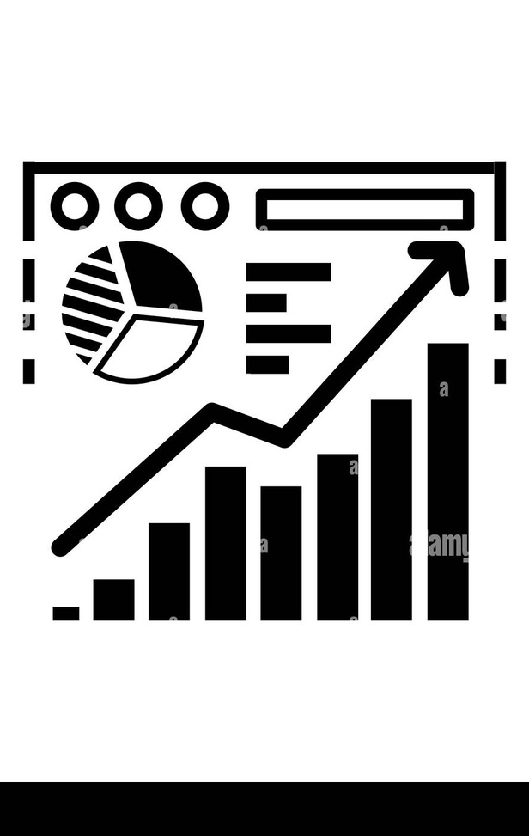




Thank you.
Thank you for your support and time.
Happy
Our happy dog.

